Slide 1


Beat Invaders

Slide 2


INTRODUCTION
Mercury is the closest planet to the Sun and the smallest one in the Solar System—it’s only a bit larger than our Moon. The planet’s name has nothing to do with the liquid metal, since it was named after the Roman messenger god, Mercury

Slide 3
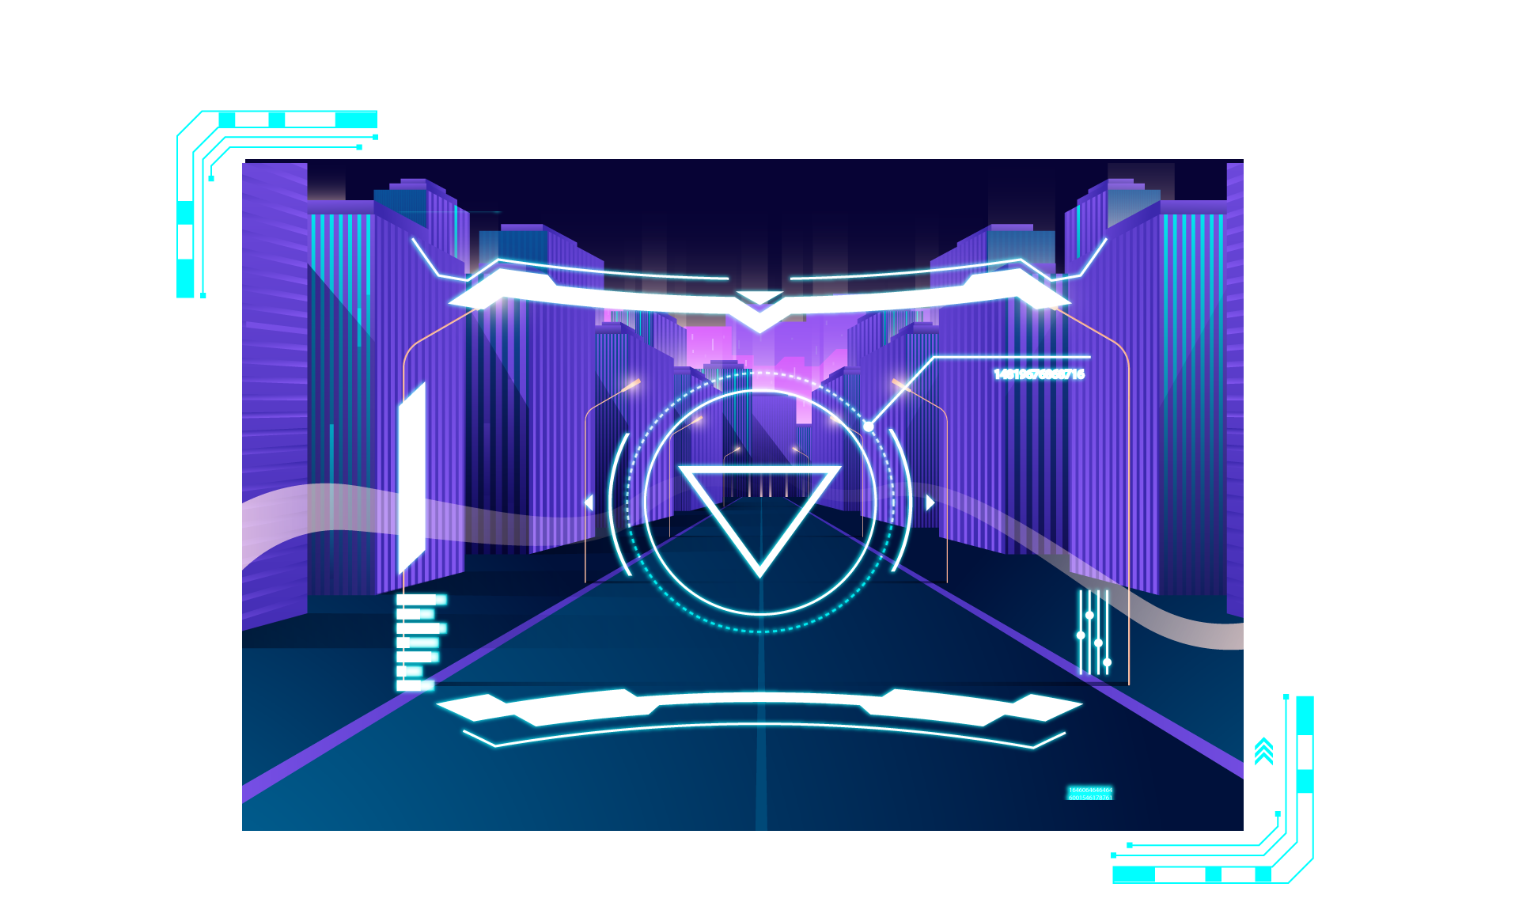
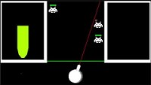

Beat Invaders

Slide 4
The Beat Team

Slide 5




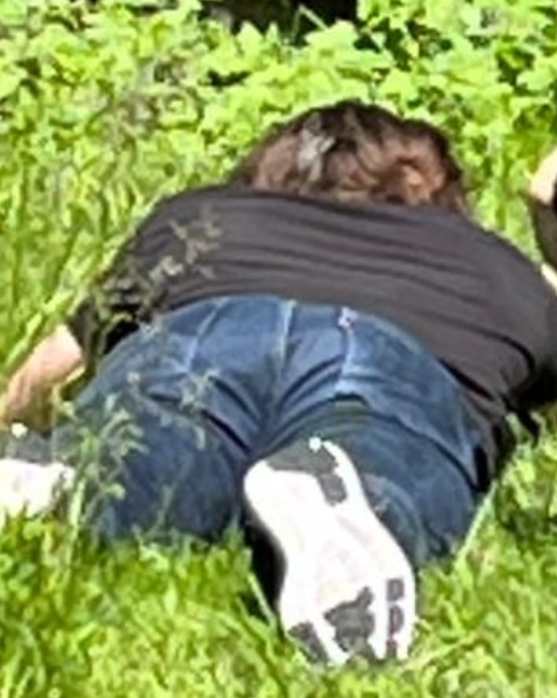
THE BEAT TEAM
Mano
Cool coder 1
Tim
Cool coder 2
Rover
Paperboy

Slide 6


PROBLEM AND BENEFIT

Slide 7
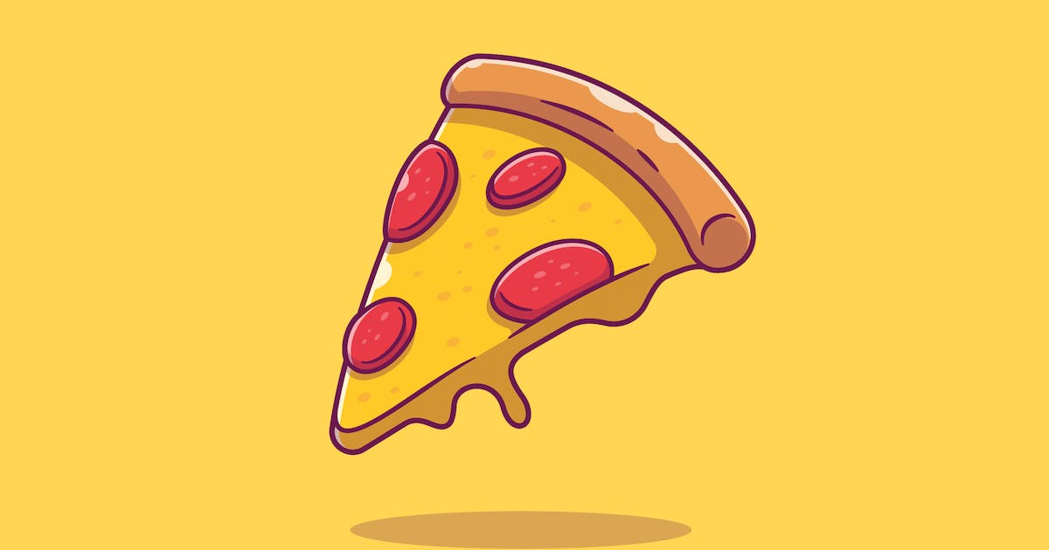
What we need - Crunch for The Crunch

Slide 8
Pizza purpose
Some one that can show us the way

Slide 9
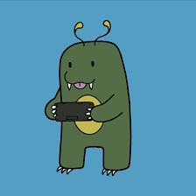
Tit for Tat

Slide 10

Timeline
16/7/2
23/7/23
9/7/23
Pizza night two
Pizza night three
31/7/23
Itch.io Release date
Pizza night one

Slide 11

Pizza your way to the future

Slide 12
THANKS
Does anyone have any questions?
beat@team.com
+123456789
beatteam.com

Slide 13
CREDITS
This is where you give credit to the ones who are part of this project.
Presentation template by Slidesgo
Icons by Flaticon
Infographics by Freepik
Author introduction slide photo created by Freepik
Text & Image slide photo created by Freepik.com

